Slide 1
BIRT In Depth
Extending and Using the BIRT Framework

Slide 2
BIRT In Depth – Who are we? Who are you?
Who are we?
  Scott Rosenbaum
    Innovent Solutions, Inc. BIRT PMC
  Krishna Venkatraman
    Actuate Corporation BIRT Product Manager
  Jason Weathersby
    Actuate Corporation BIRT Evangelist, BIRT PMC
Who are you?
  Name, Company, technical background (C, SQL, java, reporting…)
  Experience with BIRT
  What are you hoping to get out of today’s presentation?

Slide 3
BIRT Tasks – Audience
Easy Hard
End Users
Advanced BIRT Users
Deploy Experts
Reporting Integration
BIRT Extension
BIRT Core Development
Drag&Drop, Properties
BIRT Script / ScriptAPI
BIRT Viewer / Engine API
Design Engine API
BIRT Extension Points
Eclipse Development
_{Presentation}
_{Focus}

Slide 4
Agenda
BIRT Introduction 30 minutes
  API Overview, Report Dev Example, BIRT Install (Class CD)
BIRT Scripting 45 minutes
  Expressions, JavaScript, Event Handlers
Deploying BIRT 30 minutes
  Web Viewer, RCP, Servlet
Break 15 minutes
Integrating BIRT 30 minutes
  Report Engine API, Design Engine API
Extending BIRT 30 minutes
  Extension Point overview, examples
Using Charting 30 minutes
  Chart Overview, Stand-Alone chart demo

Slide 5
BIRT API Overview
BIRT Reports use four Eclipse technologies
  1 Eclipse Report Designer (ERD)
  2 Data Tools Project – Open Data Architecture (DTP ODA)
  3 Eclipse Report Engine (ERE)
  3 Eclipse Charting Engine (ECE)
Eclipse
Report
Designer
Data Tools
Project
Open Data Architecture
ODA
Report Engine
1
2
Data Transform.
Services
Charting
Services
4
HTML
PDF
Print
XML
…
3
Report Design Engine
Generation
Services
Presentation
Services
XML
Report
Design
Data
Report
Document

Slide 6
BIRT Introduction – The Quick Tour
The BIRT Perspective
  Data View, Palette, Outline View, Layout, Code, Preview
BIRT Data
  Data Sources, Data Sets, Parameters
BIRT Layout
  Grids, Tables, Controls, Data Binding
BIRT Code
  Expression Builders vs. Code Pages
BIRT Preview
  HTML View, BIRT Viewer, PDF Viewer
Deploying BIRT
  J2EE Deploy, RCP Deploy, Other
Notes:
This is a live demo of building a basic report using a standard jdbc data source, data set and a standard grid with a table and a chart. In addition, the report should be deployed into a J2EE container (probably JBOSS).

Slide 7
BIRT Installation
Binary Distribution
  BIRT Report Designer All-In-One
  BIRT Report Framework
  BIRT RCP Report Designer
  BIRT Runtime
  BIRT Charts
  Other Files
BIRT Source Distributions
  BIRT CVS
  Data Tools Project CVS (DTP)
  Other Files
    iText
    Prototype.js

Slide 8
Tutorial Distribution CD
BIRT Binary Distributions
  All-In-One, Framework, RCP, Runtime, Charts, Sample DB
BIRT CVS Build 2.0.1
  BIRT Source, Data Tools Project (DTP) Source
  prototype.js, iText.jar added to appropriate locations
BIRT All In One
  iText, protoype.js added to appropriate locations
MySQL Database
  MySql-essential
  MySql-Connector
  MySql-administrator
Tutorial Demonstrations

Slide 9
Demo – Using BIRT Source Distribution
Building BIRT
BIRT Java Docs
BIRT Viewer Build
Demonstration of running BIRT through the runtime
Problems and Logging

Slide 10
Agenda
BIRT Introduction
BIRT Scripting
Deploying BIRT
Break
Integrating BIRT
Extending BIRT
Using Charting

Slide 11
BIRT Scripting
Who should use it?
What is it?
What can it do?
How does it work?

Slide 12
Scripting – Who Should Use It?
BIRT Report Developers
  Understanding of BIRT reports
  Understanding of basic programming
BIRT Lead Developers
  Encapsulation of complex functionality
  E.g. Smart Data Source (connects to DS based on environment)
Java Developers
  Create java objects that interact with BIRT reports

Slide 13
Scripting – What Is It?
BIRT JavaScript
  Mozilla Rhino Scripting (http://www.mozilla.org/rhino/)
  Server Side Scripting
    This is not browser based (DOM)
    This is not Monkey (Eclipse based script)
  Extended with custom BIRT Objects, Methods, and Constants
Expressions
  Report component property
  Provides runtime resolution of value
  E.g. filters, valueExpr, tocExpr, linkExpr
Events
  Factory Events
  Presentation Events
  Event Handlers Work extend a specific BIRT Event
    JavaScript Event Handlers – Accessed through the code tab
    Java Event Handlers – Java Objects that are invoked by the Java event

Slide 14
BIRT Script – Functions
DateTime
  addDate, addTime, days, hours, minutes, months, seconds, subDate, subTime, years
Finance
  ddb, fv, ipmt, irr, mirr, nper, npv, percent, pmt, ppmt, pv, rate, sln, syd
Total
  ave, count, countDistinct, first, irr, last, max, median, min, mirr, mode, movingAve, npv, runningNpv, runningSum, stdDev, sum, variance, weightedAve

Slide 15
Expressions – Always Return a value
Use BIRT Script
  Access to the Row
  JavaScript
  BIRT Script Functions
Evaluate to a value
  String, Binary, blob, …
Structure expressions
Element expressions
Design Time Only Expressions
  Not settable through script (more on this later)

Slide 16
Expressions – Structures
MapRule
  testExpr, value1, value2
HighlightRule
  testExpr, value1, value2
SortKey
  key
FilterCondition
  expr,value1, value2
HideRule
  valueExpr
DataSetParam
  defaultValue
ParamBinding
  expression
ComputedColumn
  expression
SearchKey
  expression
Action
  uri
  targetBookmark
PropertyBinding
  value

Slide 17
Expressions – Elements
ScalarParameter.dynamicList
  valueExpr, labelExpr
ReportItem
  bookmark, toc
Data
  valueExpr
ListingGroup
  keyExpr
  toc
Row
  bookmark
Image
  uri
  valueExpr
  typeExpr
TextData
  valueExpr

Slide 18
Expressions - Demo
Creating a Filter
Creating a Custom Field
Create a Highlight
Create a Hyperlink

Slide 19
BIRT Events
Extend / modify pre-defined points during report execution
Generation Phase
Presentation Phase
BIRT Events
Report Level
Initialize
beforeFactory
afterFactory
Report Element
onPrepare
onCreate
Report Level
Initialize
beforeRender
afterRender
Report Element
onRender
Data Source/Set
beforeOpen
afterOpen
onFetch
beforeClose
afterClose

Slide 20
Events - Run then Render Pipeline (Web viewer)
Report
Designer
Design
Engine
Java Event Handlers
JavaScript Event Handlers
RptDesign
XML
Generation Phase
Presentation Phase
Paginated HTML
PDF
CSV
Report Engine
JDBC
XML
FlatFile
Scripted
RptDocument
Report
Document
optional

Slide 21
Events - Run then Render Pipeline (Web viewer)
Generation Phase
Initialize
Report
onPrepare
onPrepare
Table
onPrepare
Row
beforeFactory
DataItem
beforeOpen
Data Set
afterOpen
onFetch
onCreate
onCreate
onCreate
beforeClose
afterClose
afterFactory
Presentation Phase
beforeRender
onRender
onRender
onRender
afterRender

Slide 22
Events - Run & Render Pipeline (Default Preview)
Report
Designer
Design
Engine
Java Event Handlers
JavaScript Event Handlers
RptDesign
XML
Generation and Render Phase
Paginated HTML
PDF
CSV
Report Engine
JDBC
XML
FlatFile
Scripted
RptDocument
Report
Document
optional

Slide 23
Events - Run & Render Pipeline (Default Preview)
Initialize
onPrepare
onPrepare
Report
onPrepare
Table
beforeFactory
Row
beforeRender
DataItem
beforeOpen
Data Set
afterOpen
onFetch
onCreate
onRender
onCreate
onRender
onCreate
onRender
beforeClose
afterClose
afterRender
afterFactory

Slide 24
Events – What Can They Do
Standard Uses of Events
  Dynamic control of Properties (typically done at onCreate)
  Dynamic control of Expressions (only valid for onPrepare)
  Creation of Custom Methods
  Integration with Java objects
  Control of Global Variables
  Integration with J2EE Application/Session objects
BIRT Fu Event Integration
  Doing too much with Event Handling (beyond design constraints)
  Possible but may be problematic (Low Bang for the Buck)
  No Guarantee of Future Support

Slide 25
Events – Create Custom Methods
Extend BIRT JavaScript
Create a JavaScript Method
Save the Method as a Global Variable
  reportContext.setPersistentGlobalVariable (“funcName”, function);
    Accessible from the render task
  reportContext.setGlobalVariable(“funcName”, function);
    Not accessible from the render task
Function is available to any JavaScript Method
  Chart Scripting is a special case
Function is available to any Expression
Use Libraries / Templates to make the solution re-usable

Slide 26
Events – Plain Old Java Objects
BIRT Event interface with POJOs natively
  Expressions
  JavaScript Event Handlers
  Java Event Handlers
Location of POJO Classes / Libraries
  WEB-INF/lib or WEB-INF/classes
    Requires Restart
  BIRT_VIEWER_SCRIPTLIB_DIR
    Only work with Java Event Handlers (enhancement request in)
    Searched Automatically
Instantiated within the report
Passed to the report through the Engine API

Slide 27
Events – Global Variables vs. Application Objects
Global Variables
  Tied to a specific report
  Allow sharing of an object or variable between multiple elements
  Limited to the scope of the report
  E.g. Nested Report
Application Objects
  J2EE Session or Application Objects
  Allow outside application to control / modify report behavior
  Allow report to influence web application behavior
  Allow reports to share information
  E.g. Report Data content based on J2EE Login credentials
  E.g. Report Connection based on Web Environment

Slide 28
Events – BIRT Fu Discussion
Example: Dynamic Creation of Columns
  Not supported by current scripting model
  BIRT Fu Solution, create an event handler too:
    Use the Engine API to open the design file
    Use the Design Engine API to modify report design
    Use the Engine API to read new report design and run report
  BIRT Fu Problems
    This is not trivial
    Environment doesn’t support the complexity
  Better Solution
    Embed the EngineAPI and DEAPI code upstream of the report
    Keep the Report Simple (minimize the scripting requirements)

Slide 29
Event Handlers
JavaScript Event Handlers
  Access is through the Code Tab
  Code Completion
  Easy Access to the Row variable
  Access to all BIRT functions
Java Event Handlers
  Written as POJO’s that either:
    Extend …engine.api.script.eventadapter (preferred)
    Implement …engine.api.script.eventhandler
  Debug / Step Through in Run Time environment
  Requires deployment of Java Event Handlers with the report

Slide 30
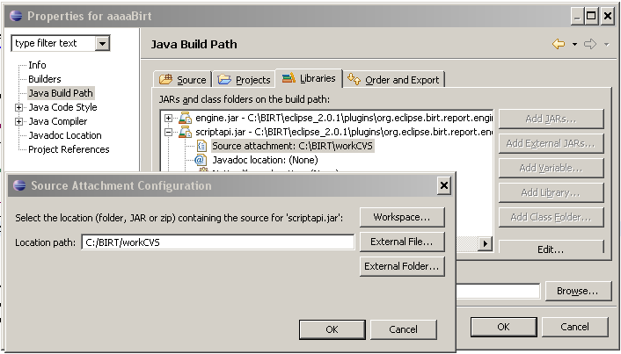
Events – Enabling Java Event Handlers
Add scriptapi.jar to the project
Place event handlers in BIRT_VIEWER_SCRIPTLIB_DIR (web.xml) parameter
Optional attach source

Slide 31
Events – JavaScript Event Handler Demos
Demonstration of Logging
Dynamic control of Properties
Dynamic control of Expressions
Creation of custom methods
Control of global variables
Integration with Java objects
Integration with J2EE Application/Session objects

Slide 32
Events – Java Event Handler Demos
Demonstration of Logging
Dynamic control of Properties
Dynamic control of Expressions
Creation of custom methods
Control of global variables
Integration with Java objects
Integration with J2EE Application/Session objects

Slide 33
Agenda
BIRT Introduction
BIRT Scripting
Deploying BIRT
Break
Integrating BIRT
Extending BIRT
Using Charting

Slide 34
Deploying BIRT
Web Viewer Example
RCP application
BIRT Servlet

Slide 35
Deploying BIRT Reports
Paginated HTML, PDF, TOC, Bookmarks, CSV
Eclipse Plugin
J2EE AS
J2EE AS
Web Viewer
Web Viewer
Custom Servlet
Java Application
ReportEngine
ReportEngine
ReportEngine
ReportEngine
RptDesign
XML
Design File
RptDocument
Report
Document
RptDesign
XML
Design File
RptDocument
Report
Document
RptDesign
XML
Design File
RptDocument
Report
Document

Slide 36
Deploy the Web Viewer Example
The BIRT Preview essentially uses the same example deployed on the internal Tomcat Plugin.
Download the Report Engine (birt-runtime-2_0_1.zip)
Copy Web Viewer Example to Webapps or deploy as WAR file.
Make sure to get Prototype.js and iText.jar
DEMO

Slide 37
Anatomy of the BIRT Viewer
BIRT Report Viewer Client
BIRT Report Viewer Server
Report Engine Service
ExecuteReport
GetReportParameterDefinitions
GetPage
GetPageCount
GetToc
ExtractReportItemData
Toolbar
Page Navigation
TOC
Parameters
Export Data
URLs
Viewer
Fragments
AJAX
SOAP
Document Handler
_{ParameterAccessor.java}
_{ViewerAttributeBean.java}
_{DocumentProcessor.java}
_{ReportEngineService.java}
Notes:
ParameterAccessor.java – Used to retrieve URL Parameters
ViewerAttributeBean.java – Used to pass data between calls and to communicate with the ReportEngine Service
DocumentProcessor.java – Fired up by the SOAP Endpoint and handles the BIRT Viewer AJAX operations.
ReportEngineService – Encapsulates the ReportEngine API to execute and render reports.

Slide 38
URLs
http://sitePrefix/birt-viewer/frameset?option1=value1;option2=value2
http://sitePrefix/birt-viewer/run?option1=value1;option2=value2
__format – The output format, only for /run
__page – Page to display, only for /frameset
__isnull – Identifies that a report parameter has a null value
__locale – Report locale
__report – The path to the report design
__document – The location of the report document
__svg – Enable svg support
__overwrite – Manually overwrite existing report document
Parametername=value

Slide 39
WEB.XML
BIRT_VIEWER_LOCALE – Standard Locale to use
BIRT_VIEWER_REPORT_ROOT – Not currently used
BIRT_VIEWER_WORKING_FOLDER – Uses this directory if the report name is relative
BIRT_VIEWER_IMAGE_DIR – The directory where the Report Engine Service will create images used in reports. This can be relative or full
BIRT_VIEWER_LOG_DIR - The directory where the Report Engine Service will log. This can be relative or full
BIRT_VIEWER_LOG_LEVEL – java.util.logging.Level
BIRT_VIEWER_SCRIPTLIB_DIR – Used for Java Event handlers. This can be relative or full

Slide 40
BIRT Viewer Construction Fragment Example
_{Frameset Fragment}
_{Toolbar Fragment}
ToolbarFragment.jsp
_{Report Fragment}
_{Sidebar Fragment}
_{TOC Fragment}
TocFragment.jsp
_{ParameterDialog Fragment}
ParameterDialogFragment.jsp
_{SimpleExport Fragment}
SimpleExportDataDialogFragment.jsp
_{ReportContent Fragment}
_{NavigationBar Fragment}
NavigationbarFragment.jsp
_{Document Fragment}
_{Progress Fragment}
ProgressBarFragment.jsp
_{DialogContainer Fragment}
DialogContainerFragment.jsp

Slide 41
Embedding BIRT in an RCP Applicaiton
Call the Engine Code Directly
  Include the Report Engine JARs and set BIRT Home
Call the WebViewer (Utility Class for starting the BIRT Viewer)
  Include BIRT plugins and use one of the following commands
  DtpManifestExplorer.getInstance( ).getExtensionManifests( );
  WebViewer.display(”C:/work/test/testSampleDB.rptdesign”, WebViewer.HTML,false);
  DtpManifestExplorer.getInstance( ).getExtensionManifests( );
  WebViewer.display(”C:/work/test/testSampleDB.rptdesign”, WebViewer.HTML,myBrowser);
    DtpManifestExplorer used to load DTP plugins

Slide 42
BIRT RCP Demo

Slide 43
Build your own Servlet using the BIRT Engine
Manual – Easier ways WTP.
Create a Directory ie (WebReport)
Copy the plugins directory from the Report Engine to the WebReport Directory.
Create an images, reports, and WEB-INF below report.
Create web.xml and under WEB-INF/lib add all the Report Engine jars.
If you build your servlet using Eclipse add all the Report Engine jars to the buildpath. Also add servlet.jar.
Make sure to use ServletContext if you are planning on deploying to a war later.
See WebReport demo

Slide 44
Build your own Servlet using the BIRT Engine
IPlatformContext
  PlatformFileContext – Used by default, uses file IO to load plugins etc.
    config.setEngineHome( servletContext.getRealPath("/WEB-INF"));
    config.setEngineHome(“c:/re/Report Engine”);
  PlatformServletContext – Used for Web (war) deployment.
    config.setEngineHome("");
    IPlatformContext context = new PlatformServletContext( servletContext, URLtoExamine /*http://host:port/birt*/ );
    config.setEngineContext( context );

Slide 45
BIRT Custom Servlet Demo

Slide 46
Agenda
BIRT Introduction
BIRT Scripting
Deploying BIRT
Break
Integrating BIRT
Extending BIRT
Using Charting

Slide 47
Agenda
BIRT Introduction
BIRT Scripting
Deploying BIRT
Break
Integrating BIRT
Extending BIRT
Using Charting

Slide 48
BIRT APIs
Report Engine API – Loads and executes design files.
Design Engine API – Creates and modifies report designs.
Charting API – Builds and renders charts. Covered Later.
Additional APIs – Not Covered.
  Data Engine API – Connects to Data Sources and executes Queries, retrieves Metadata etc.

Slide 49
Report Engine API
Used to integrate run-time portion of BIRT into your application.
Used to discover and set parameters.
Run a report and output PDF/HTML.
Fetch an image or chart for a report.
2.0 Engine supports additional features for paging, cascaded and dynamic parameters, etc.
Example in the runtime download.

Slide 50
EngineConfig
Set configuration variables such as Engine Home and Log configuration
Open Report Design and Documents. Create Engine Task.
ReportEngine
Generate one or more tasks
DataPreviewTask
Execute Report Data Sets
GetParameterDefinitionTask
Retrieve Parameters and their properties
RunAndRenderTask
Generate HTML or PDF Document
DataExtractionTask
Export Data, used for CSV
RunTask
RenderTask
Generate Paginated HTML or PDF Document
RptDesign
XML
Design File
RptDocument
Report
Document
RptDesign
XML
Design File
RptDocument
Report
Document
RptDesign
XML
Design File
RptDocument
Report
Document
Retrieve TOC and Bookmarks

Slide 51
Report Engine API
EngineConfig – Set options for the report engine.
ReportEngine – Used to run one or more Report Task
IReportRunnable – Used to open a report design and pass to the engine task. Handle to the report design.
IReportDocument – Used to open a report document and pass to the engine task. Also has methods for getting TOC, Data etc
HTMLRenderContext – Defines render context. Used for image and action handling, ie Image locations for HTML.
PDFRenderContext – Defines render context for PDF. Used for font manipulation, ie action handling, font directory and embedded fonts.
HTMLRenderOption – Set options such as output location, format, embeddable etc.

Slide 52
Report Engine Pseudo
EngineConfig config = new EngineConfig();
  //setup config
  ReportEngine engine = new ReportEngine( config );
  //open report and create a run task
  design = engine.openReportDesign( designName );
  IRunAndRenderTask task =engine.createRunAndRenderTask( design );
  //set image dirs
  HTMLRenderContext renderContext=new HTMLRenderContext();
  //configure rendering options
  HTMLRenderOption options = new HTMLRenderOption();
  task.setRenderOption(options);
  //run report
  task.run();

Slide 53
Report Engine API Optional
IHTMLActionHandler – Implement to build custom hyper-linking
  Can be set using HTMLRenderOptions or HTMLEmitterConfig.
IHTMLImageHandler – Used to create custom image handler
  Defaults to HTMLCompleteImageHandler
  HTMLServerImageHandler – Used by BIRT Viewer to read images through Servlet.
HTMLEmitterConfig - Used to set custom action handler and image handler.

Slide 54
Design Engine API
Create and modify report designs.
Create and delete report elements.
Put report elements into slots.
Get and set parameter values.
Retrieve metadata from report elements, properties and slots.
Undo/Redo
Semantic Checks on report designs.

Slide 55
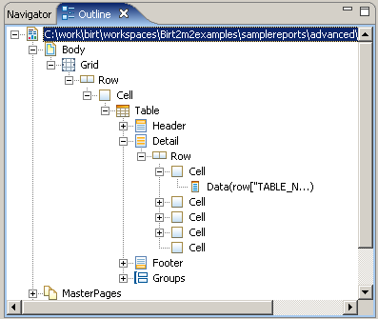
Design Engine API
Elements – Report Objects such as Table, Label, Style etc.
Properties – Modify the Element state and often support inheritance. Discussed in ROM specification.
Slots – Describes element - container relationships. For example a Report element contains slots for Data Sources, Data Sets, Report Body, etc.

Slide 56
Design Engine API
SessionHandle – Used to open one or more designs.
ReportDesignHandle – Handle to specific report design.
ElementFactory – Creates new report elements
DesignElementHandle – Handle to created element.
  GridHandle, RowHandle, CellHandle, etc
SlotHandle – Handle to a Slot. Used to add element to design, using add method. Eg, design.getBody(), cell.getContent()

Slide 57
Design Engine Pseudo
  SessionHandle session = DesignEngine.newSession( null );
  // Create a new report design.
  ReportDesignHandle design = session.createDesign( );
  // setup element factory
  ElementFactory factory = design.getElementFactory( );
  // Create a simple master page
  DesignElementHandle element =
  factory.newSimpleMasterPage( "Page Master" );
  //Get SlotHandle and add element
  design.getMasterPages( ).add( element );
  //Save and close report design
  design.saveAs( "c:/work/temp/test.rptdesign" );
  design.close( );

Slide 58
API Demo Examples
DataPreviewTask
  Preview Result Set
GetParameterDefinitionTask
  Get parameters and metadata, including dynamic parameters
RunAndRenderTask
  Run and Render a report design to html
RunTask
  Run a report design and create a report document
RenderTask
  Render an HTML document based on a report document
DataExtractionTask
  Extract data that is stored in the report document
DrillDown
  Execute a master report and customize links to a detail report.
TOCExtract
  Open a report document and retrieve the top level TOC
CreateReport
  Build a simple report using the DE API
ScriptObject
  Add an object to the BIRT JavaScript

Slide 59
Agenda
BIRT Introduction
BIRT Scripting
Deploying BIRT
Break
Integrating BIRT
Extending BIRT
Using Charting

Slide 60
Extension
What is BIRT Extension
Creating Custom Data Sources
Creating a Custom Emitter

Slide 61
Extension – What is It?
Tools Covered so Far
  The standard reporting interface
  Engine API
  Design Engine API
  Scripting
What if you have a task that can not be done with std. tools?
You have a solution, but it required BIRT Fu?
You would like to add your extensions to the standard BIRT UI ?
  Provide easy access to less sophisticated developers
  Provide better error handling, integration, etc.

Slide 62
Extension – BIRT Extension to the Rescue
BIRT Uses the Eclipse Extension Framework
BIRT has pre-defined Extension Points built into the Framework
Allows Users to Develop Custom BIRT functionality
Process is identical to the Eclipse Plugin Development Process
BIRT Extension Skills
  Eclipse Plug-In Developer
  Requires Knowledge of the BIRT Framework
  This is not a trivial task
Benefits
  Complete control customization of the BIRT environment
  Encapsulation into standard BIRT Elements and Objects

Slide 63
Extension – Hibernate ODA in Action
Hibernate Data Source
Created by Jason Weathersby
Full Source Code and Walk through available in the new book on BIRT from Actuate.

Slide 64
Extension – Extension Points Charts
org.eclipse.birt.chart.engine
  aggregatefunctions
    Define custom Aggregate Functions
  datasetprocessors
    Register data set processors for series that use custom data elements
  displayservers
    register a custom Display Server
  devicerenderers
    Custom implementations of device renderers
  modelrenderers
    Define series renderers for custom series types
org.eclipse.birt.chart.ui
  uisheets
    Register an attribute or data sheet with the Chart Designer UI
  types
    Register a a chart type with the Chart Designer UI.
  changelisteners
    Used if providing a dynamic attribute or data sheet for use in the UI
  seriescomposites
    Provides hooks which allow chart builder to show customized UI elements

Slide 65
Extension – Data Extension Points
org.eclipse.birt.data
  Aggregation
    Adds new functions to the Total.Function JavaScript
org.eclipse.birt.data.oda
  dataSource
    BIRT 1.0 Featured, moved to DTP in 2.0
org.eclipse.birt.report.data.oda.jdbc
  driverinfo
    An extension to supply additional information about a JDBC driver available to the JDBC-ODA Bridge. Including: Driver class name, a display-friendly driver name and a URL template
org.eclipse.datatools.connectivity.oda
  dataSource
    support the extension of design-time and run-time data source access by a data application.

Slide 66
Extension – Designer / Model Extension Points
org.eclipse.birt.core.ui
  Tasks
    Used in the Task Wizard
  taskWizards
    Create a task oriented wizard
org.eclipse.birt.report.model
  reportItemModel
    specifies how a new report item is represented and persisted in the ROM
  encryptionHelper
    supports custom encryption.

Slide 67
Extension – UI Extension Points
org.eclipse.birt.report.designer.ui
  odadatasource
    The data source extension allows providers to add their own type of data source support to the BIRT designer.
    The extension can optionally provide the following implementations for the data source.
    1) A wizard for creating the data source
    2) A set of pages for editing the data source
    3) A list of data sets that this data source supports
  reportitemUI
    used in conjunction with the Report Item extension point defined in the model. It is used to register the GUI to be used for the Extended report item.
  menuBuilders
    used to create menu items in the UI

Slide 68
Extension – Engine Extension Points
org.eclipse.birt.report.engine
  reportitemGeneration
    Specifies how the new report item should be instantiated, processed, and persisted at report generation time.
  reportitemPresentation
    Specifies how the new report item should be instantiated, processed, and rendered at presentation (rendering) time.
  emitters
    Allows new output formats to be supported in presentation engine. The plugin registry uses this extension point registration to discover all supported output formats.
  reportitemQuery
    Specifies how the data that the new report item needs should be prepared.

Slide 69
Extension – JNDI Data Source
Simple ODA that allows access to JNDI Data Sources

Slide 70
Extension – XLS Emitter
Simple implementation of a custom BIRT Emitter
Creates Excel Spread-Sheets from BIRT reports

Slide 71
Agenda
BIRT Introduction
BIRT Scripting
Deploying BIRT
Break
Integrating BIRT
Extending BIRT
Using Charting

Slide 72
Charts
Gallery of Chart Types
Creating a Chart Within a BIRT Report
Using Charting Standalone
Charting Extension Points

Slide 73
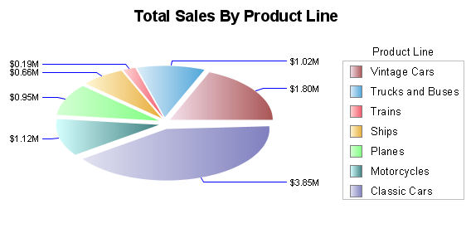
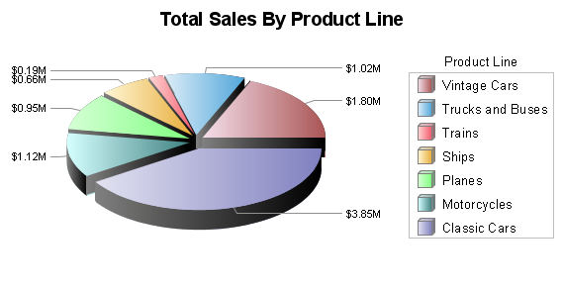
Pie Charts
2D, 2D with depth
Formatting control

Slide 74
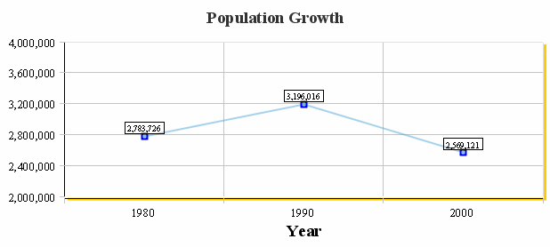
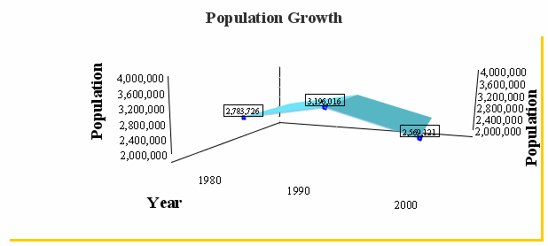
Line Charts
Horizontal, Vertical
2D, 3D
Various types of markers
Line styles, thicknesses
Drawn as Line, Curve

Slide 75
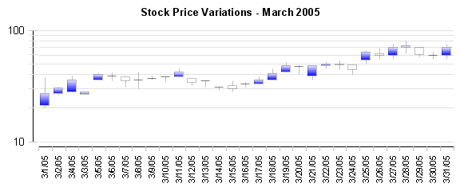
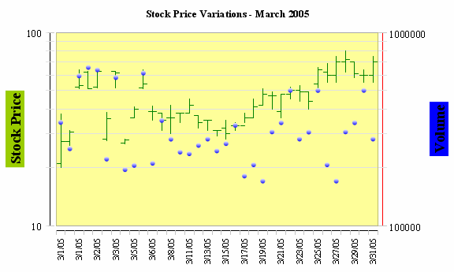
Stock Charts
Horizontal, Vertical
2D
Formatting control

Slide 76
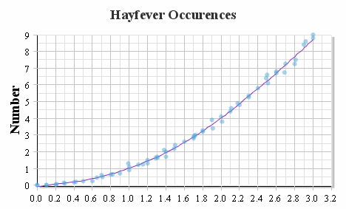
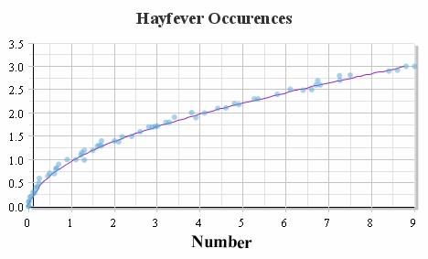
Scatter Charts
Horizontal, Vertical
2D
Various types of markers
Line styles, thicknesses
Drawn as Line, Curve

Slide 77
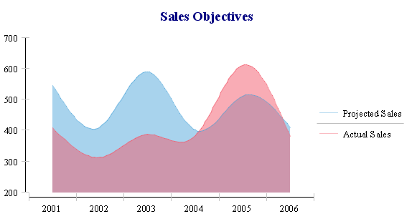
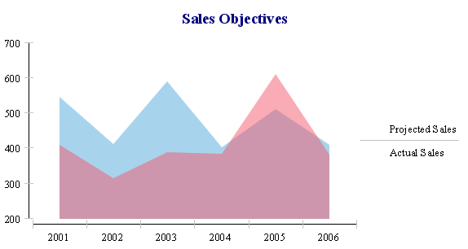
Area Charts
Horizontal, Vertical
2D, 2D w/depth, 3D
Stacked, Side-by-side
Percent, Logarithmic
Drawn as Line, Curve

Slide 78
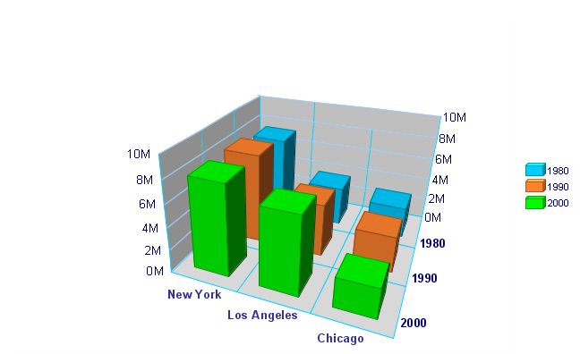
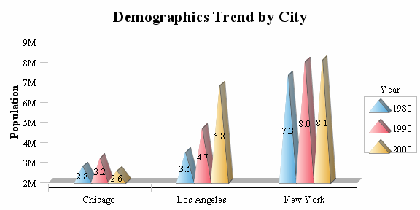
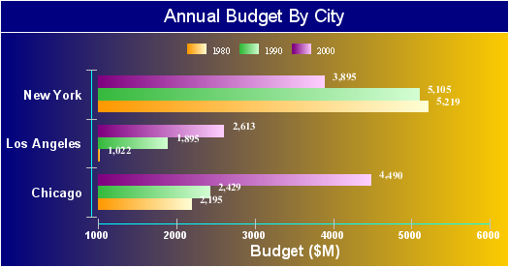
Bar Charts
Horizontal, Vertical
2D, 2D w/depth, 3D
Rectangle, Triangle Risers
Stacked, Side-by-side
Percent, Logarithmic

Slide 79
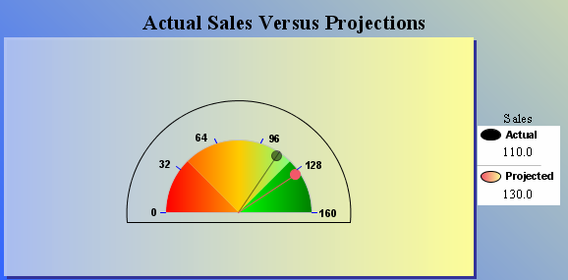
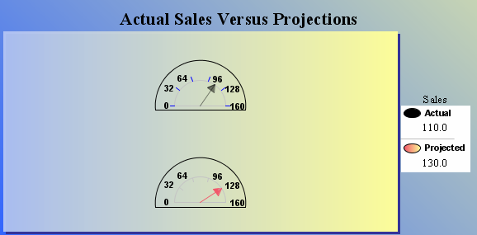
Meter Charts
2D, formatting control
Regions, Needle styles, thicknesses

Slide 80
Chart Interactivity
List of Conditions
Name | Description
onclick | Occurs when the pointing device button is clicked over an element
ondblclick | Occurs when the pointing device button is double clicked over an element.
onmousedown | Occurs when the pointing device button is pressed over an element.
onmouseup | Occurs when the pointing device button is released over an element.
onmouseover | Occurs when the pointing device is moved onto an element.
onmousemove | Occurs when the pointing device is moved while it is over an element.
onmouseout | Occurs when the pointing device is moved away from an element.
onfocus | Occurs when an element receives focus either by the pointing device or by tabbing navigation
onblur | Occurs when an element loses focus either by the pointing device or by tabbing navigation
onkeydown | Occurs when a key is pressed down on an element
onkeypress | Occurs when a key is pressed on an element
onkeyup | Occurs when a key is up on an element
onload | Occurs when the chart is loaded in the viewer
List of Actions
URL Redirect, Show Tooltip, Highlight, Toggle Visibility, Invoke Script, Call Back

Slide 81
BIRT JavaScript Functions With Charts
beforeDataSetFilled(series,dataSetProcessor, context)
beforeGeneration( chart, context )
beforeRendering( gcs, context )
beforeDrawBlock( block, context )
beforeDrawLegendEntry( label, context )
beforeDrawSeries( series, seriesRenderer, context )
beforeDrawSeriesTitle( series, label, context )
beforeDrawMarkerLine( axis, markerLine, context )
beforeDrawMarkerRange( axis, markerRange, context )
beforeDrawDataPoint( dph, fill, context )
beforeDrawDataPointLabel( dph, label, context )
beforeDrawFittingCurve( cf, context )
beforeDrawAxisLabel( axis, label, context )
beforeDrawAxisTitle( axis, label, context )
Similar list for after*() functions

Slide 82
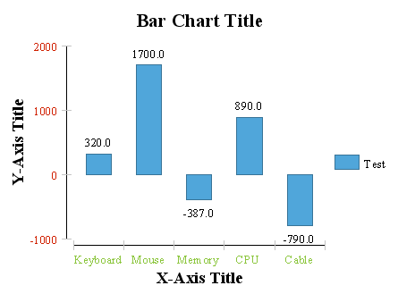
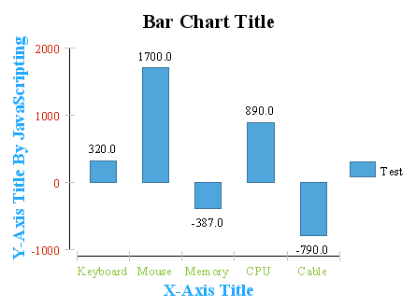
Using JavaScript With Chart
function beforeDrawAxisTitle (axis, title, context)
{
importPackage(
Packages.org.eclipse.birt.chart.model.attribute);
if (axis.getType() == AxisType.LINEAR_LITERAL)
{
title.getCaption( ).setValue
("Y-Axis Title By JavaScripting");
}
title.getCaption( ).getColor( ).set( 32, 168, 255 );
}

Slide 83
Creating a Chart Within a BIRT Report

Slide 84
Charting Standalone
Complete Charting library
  Chart Builder UI
  Chart Engine
  Out-of-the-box integration with BIRT
  Can run outside of Eclipse

Slide 85
Charting Extension Points

Slide 86
Chart – Engine Extension Points
devicerenderers
  Generates output to file format/device that supports rendering of primitives. Defaults: SWT GC context, SWING Graphics2D context, image renderers for PNG, GIF, JPEG, BMP, SVG
modelrenderers
  Defines the model for particular chart type. Higher level rendering of different series types - Stock, Pie, Line, Bar, etc.
displayservers
  Services for device renderer: text metric retrieval, image loading, detection of screen resolution. Computes chart content off-screen before rendering. Defaults: SWT, SWING
datasetprocessors
  Dataset processors for series that use custom data elements
aggregratefunctions
  Definition of chart aggregate functions such as sum for use in charts

Slide 87
Charts – UI Extension
uisheets
  Register an attribute or data sheet with the Chart Designer UI
types
  Register a a chart type with the Chart Designer UI.
changelisteners
  Used if providing a dynamic attribute or data sheet for use in the UI
seriescomposites
  Provides hooks which allow chart builder to show customized UI elements

Slide 88
BIRT In Depth – thanks for attending
Suggestions Comments Questions
Scott Rosenbaum (scottr@innoventsolutions.com)
Krishna Venkatraman (kvenkatraman@actuate.com)
Jason Weatherersby (jweathersby@innoventsolutions.com)
BIRT Design Contest
  Win a Sony PSP
  Category based on design style
  Category based on technical merit
  Designs by April 28, 2006

